Slide 1


DESIGN 1
Lesson 1: Why Forms? Starting the F1 Contact Form
Ms. Abboud • Grade 9 - Design 1 • Term 1, Week 9

Slide 2
Learning Objectives
WALT - We Are Learning To
WILF - What I'm Looking For
Explain what forms do and name their 4 core parts.
Start a contact form on the F1 Contact Us page.
I can name the 4 core form elements.
Clicking my label puts the cursor in its field.

Slide 3
Academic Vocabulary
Form
Input
The <form> tag: a container that groups fields so a website can collect information.
The <input> tag: a field where a user types or selects data.
Label
Button
The <label> tag: text that names a field and is linked to it.
The <button> tag: a clickable element, often used to submit a form.

Slide 4
Frayer Model: Input
DEFINITION
CHARACTERISTICS
The <input> tag: a field where a user types or selects data (text, email, etc.).
The <input> tag; self-closing; has a type attribute.
INPUT
EXAMPLES
NON-EXAMPLES
<input type="text" id="name" name="name"> for the visitor's name.
<label>; <p> (these display text, not collect it).

Slide 5
National Identity Integration
UAE Smart Services: most UAE government services, from visas to vehicle registration, are requested online through forms. Clear labels make sure every resident can fill them in correctly.

Slide 6
STARTER
What Is This Page Doing?
Look at a real contact form.
What can this page do that our F1 website can't do yet?
Hook • Engage & Ask
5 - 10 minutes

Slide 7
LESSON CORE
I Do: The Parts of a Form
<form> wraps the fields. <label> names a field. <input> is the box. <button> sends it.
The label's for must match the input's id.
Gradual Release of Responsibility
30 - 40 minutes
Example: the start of the F1 contact form
<form>
<label for="name">Your name:</label>
<input type="text" id="name" name="name">
<button type="submit">Send</button>
</form>
1 / 3

Slide 8
LESSON CORE
We Do: Frayer and the Name Field
Complete the Frayer Model for Input together.
Build the Name field together, then click the label to test it.
Gradual Release of Responsibility
30 - 40 minutes
2 / 3

Slide 9
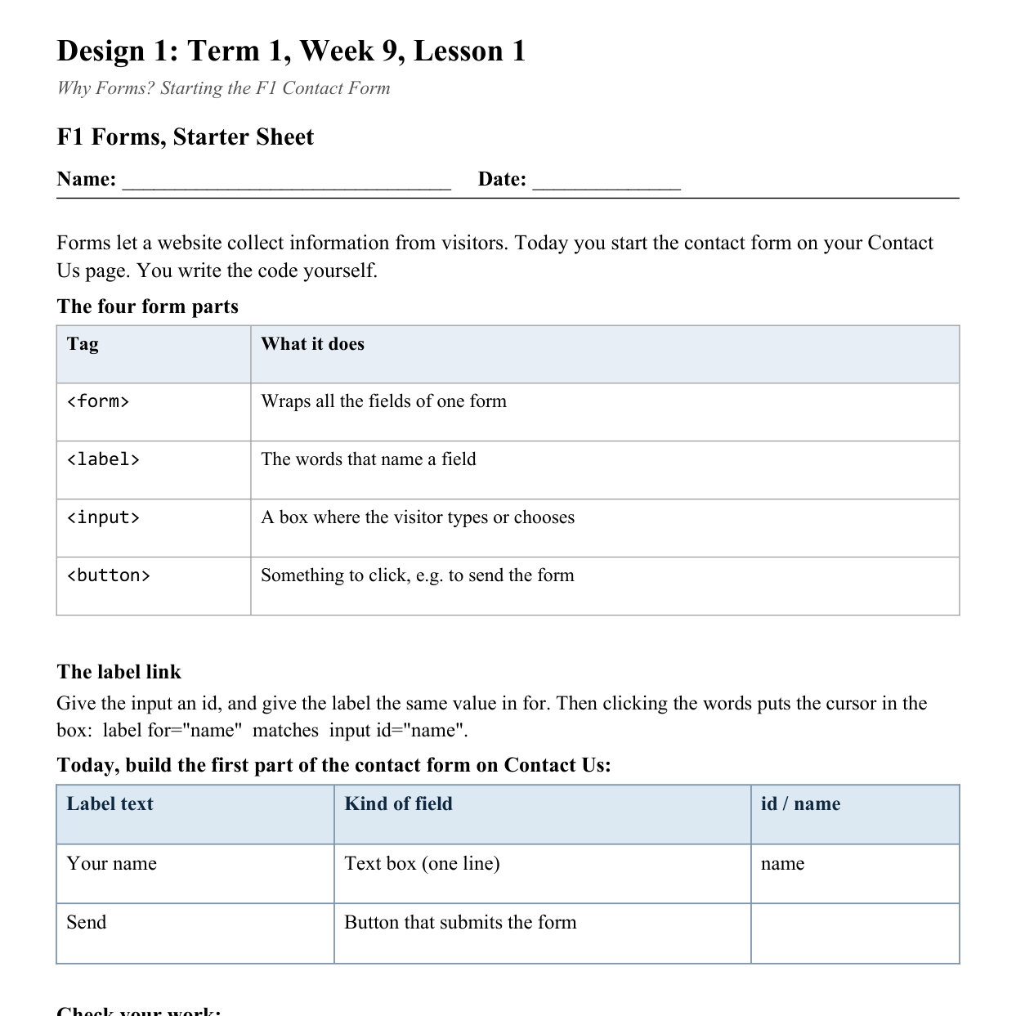
LESSON CORE
You Do: Start the Contact Form
On Contact Us, build the labelled Name field and the Send button.
You write the code from the Starter Sheet.
Activity: F1 Forms, Starter Sheet
Gradual Release of Responsibility
30 - 40 minutes
3 / 3

Slide 10
CLOSURE
Exit Ticket
Why does a form need a submit button?
Transition & Extend
5 - 10 minutes

